Slide 1
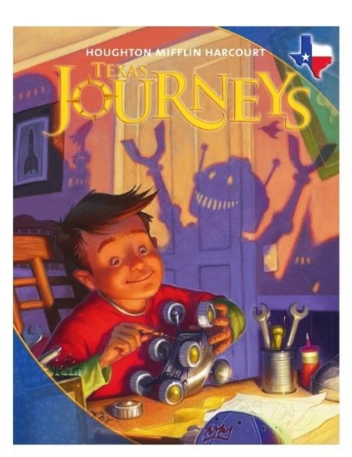

Unit 1: Lesson 4
Vocabulary
Copyright © 2011 Kelly Mott
Notes:
1

Slide 2
Part 1: Introduce Vocabulary
Copyright © 2011 Kelly Mott
Notes:
2

Slide 3
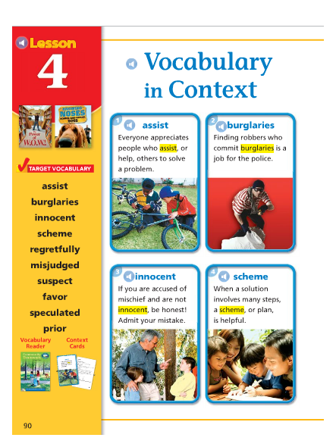
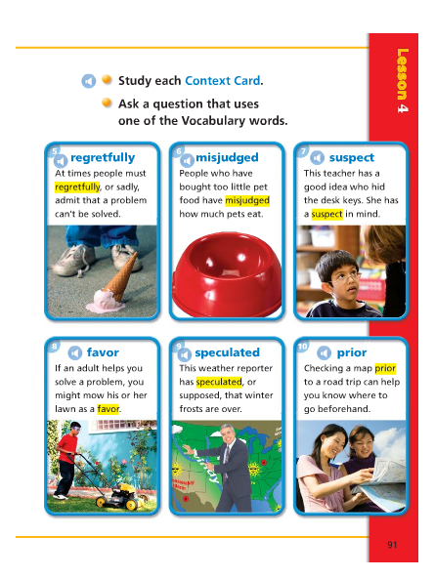
Copyright © 2011 Kelly Mott

Slide 4
assist
Copyright © 2011 Kelly Mott

Slide 5
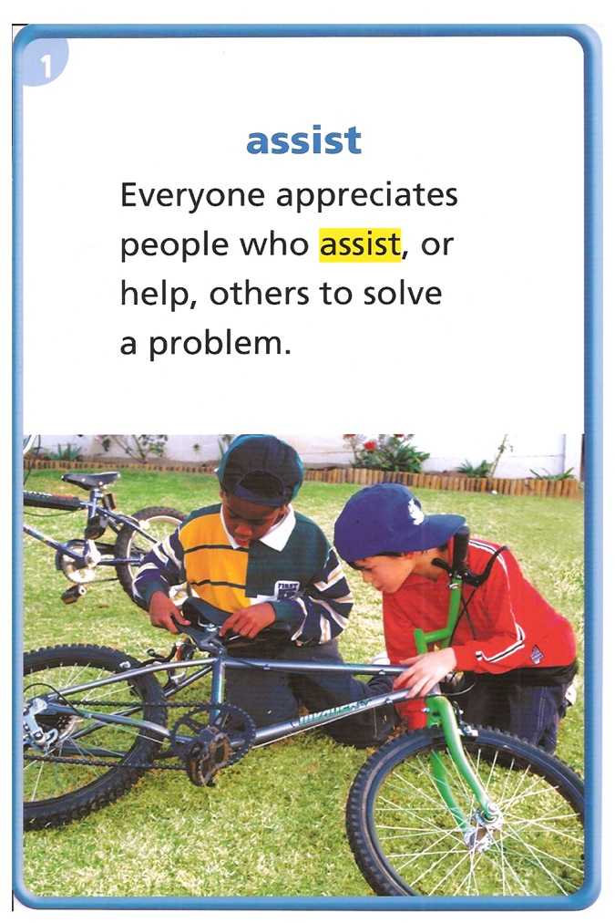
What does it mean?
To assist someone is to help that person.
THINK ABOUT IT:
Who usually comes to assist you when you need help?
Copyright © 2011 Kelly Mott

Slide 6
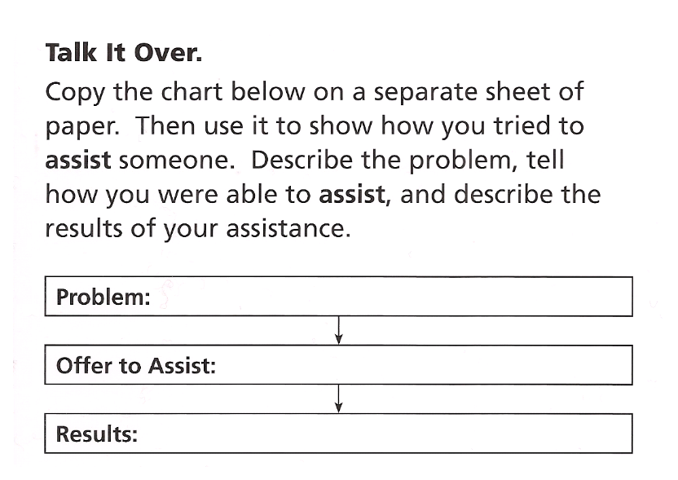
Copyright © 2011 Kelly Mott

Slide 7
burglaries
Copyright © 2011 Kelly Mott

Slide 8
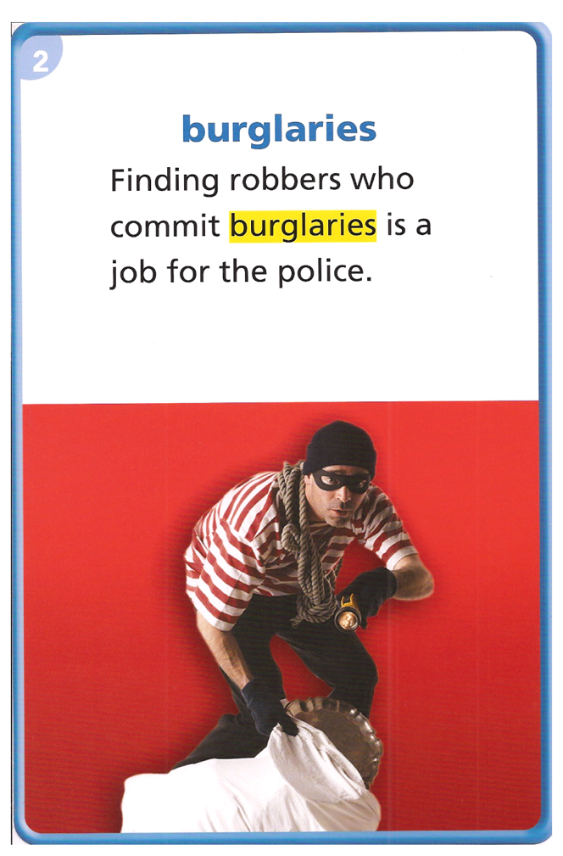
What does it mean?
People who commit burglaries break into buildings and steal things.
THINK ABOUT IT:
When your favorite superhero hears about burglaries, what does he or she do?
Copyright © 2011 Kelly Mott

Slide 9
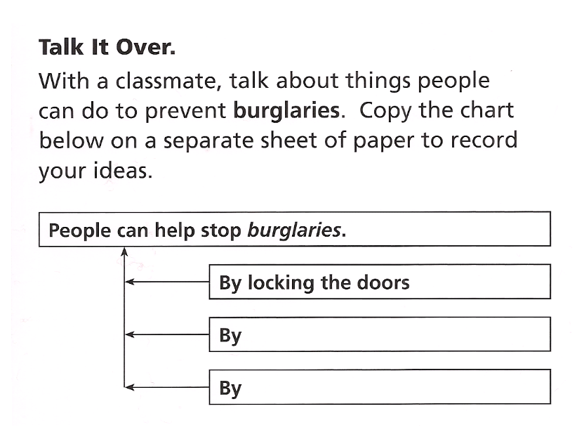
Copyright © 2011 Kelly Mott

Slide 10
innocent
Copyright © 2011 Kelly Mott

Slide 11
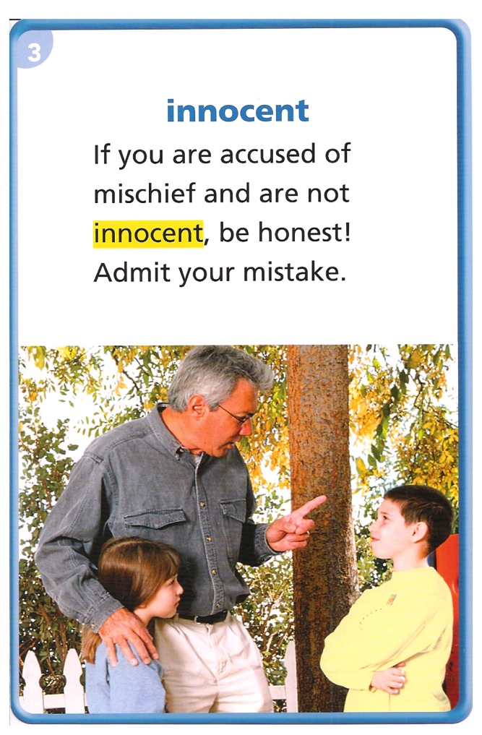
What does it mean?
A person who is innocent has done nothing wrong.
THINK ABOUT IT:
If someone is accused of a crime, how can that person prove that he or she is innocent?
Copyright © 2011 Kelly Mott

Slide 12
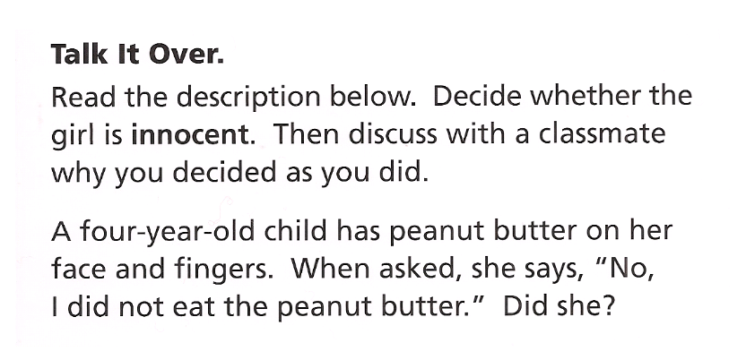
Copyright © 2011 Kelly Mott

Slide 13
scheme
Copyright © 2011 Kelly Mott

Slide 14
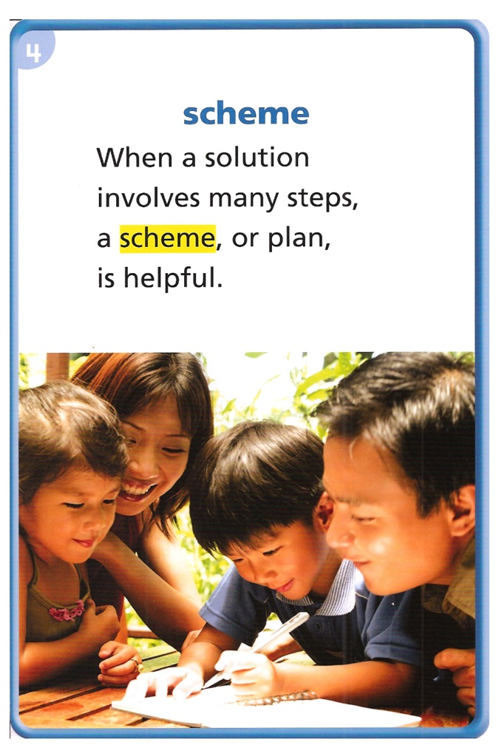
What does it mean?
A scheme is a detailed plan to get something done.
THINK ABOUT IT:
How could a scheme help you plan a surprise birthday party?
Copyright © 2011 Kelly Mott

Slide 15
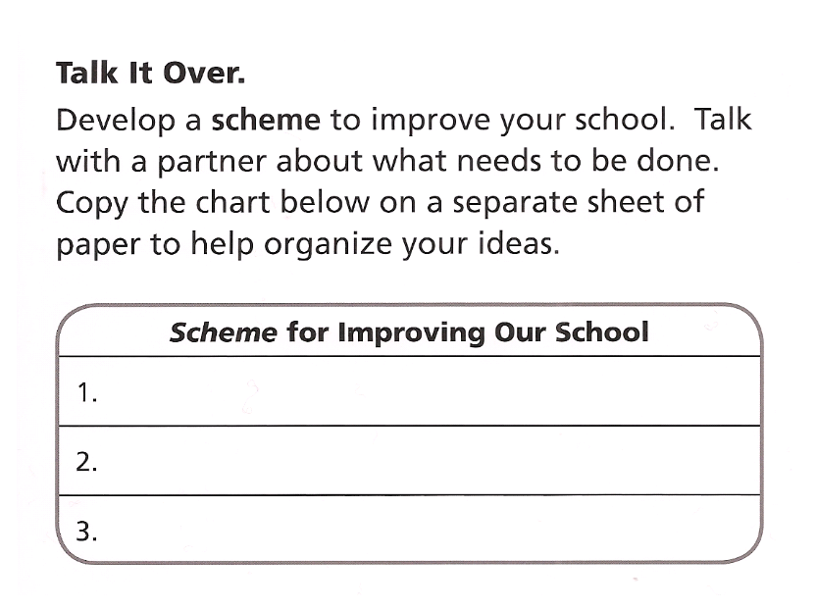
Copyright © 2011 Kelly Mott

Slide 16
regretfully
Copyright © 2011 Kelly Mott

Slide 17
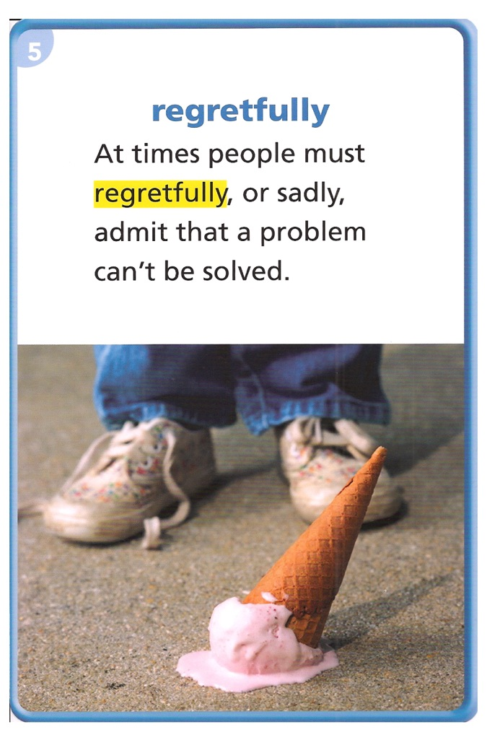
What does it mean?
If people say something regretfully, they say it in a way that shows they are sorry.
THINK ABOUT IT:
What have you said regretfully and to whom? When you spoke, how did you look and what did you do?
Copyright © 2011 Kelly Mott

Slide 18
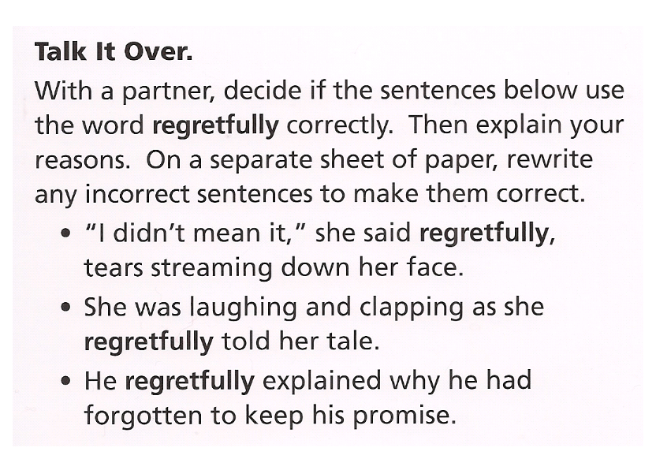
Copyright © 2011 Kelly Mott

Slide 19
misjudged
Copyright © 2011 Kelly Mott

Slide 20
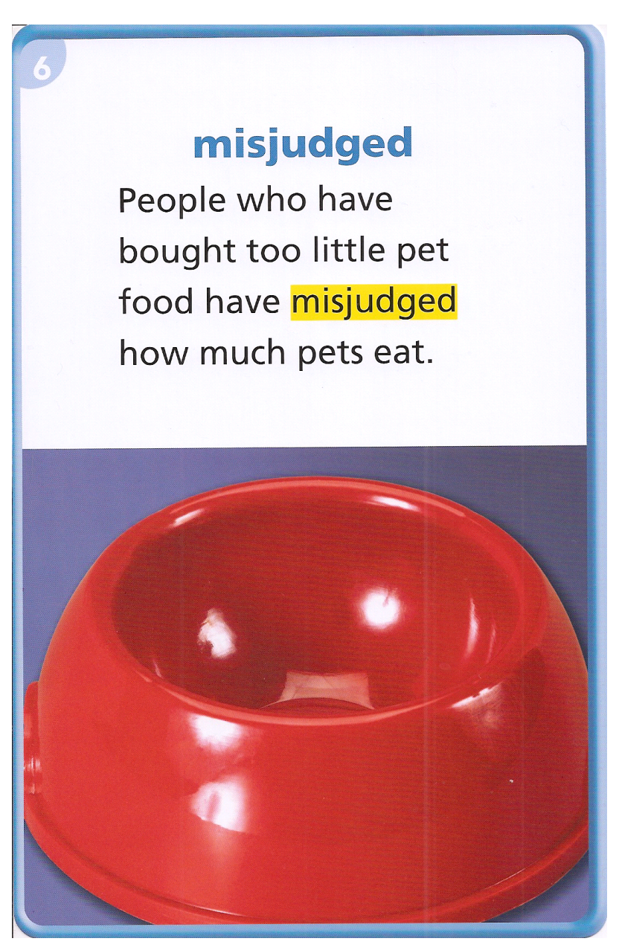
What does it mean?
If a person has misjudged something, the person has formed an incorrect idea about it.
THINK ABOUT IT:
When have you misjudged the distance of a leap or jump?
Copyright © 2011 Kelly Mott

Slide 21
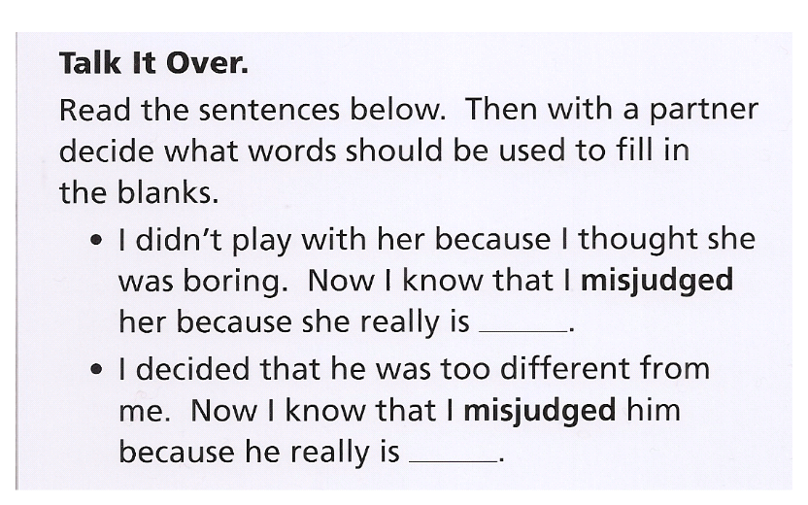
Copyright © 2011 Kelly Mott

Slide 22
suspect
Copyright © 2011 Kelly Mott

Slide 23
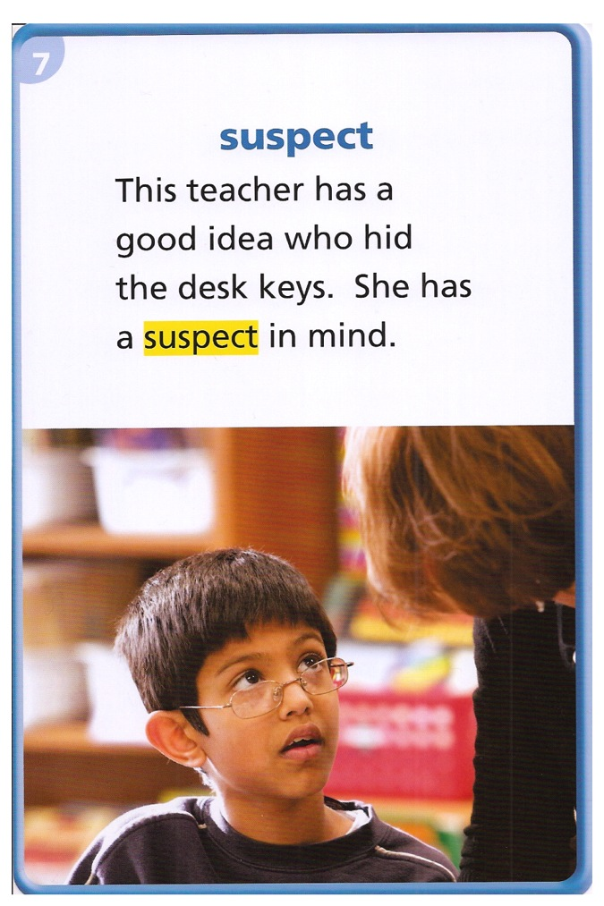
What does it mean?
A suspect is a person who people think might be guilty of a crime.
THINK ABOUT IT:
What are some ways to find out if a suspect really is guilty?
Copyright © 2011 Kelly Mott

Slide 24
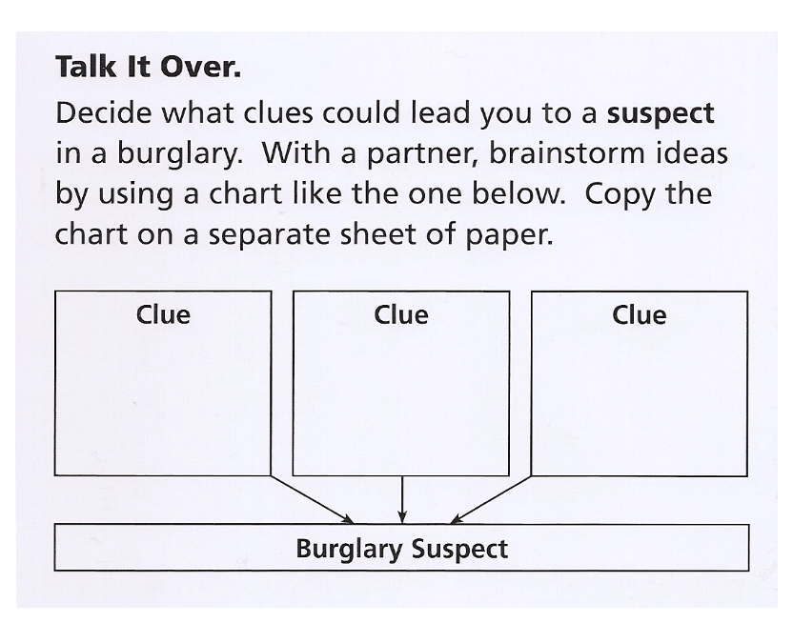
Copyright © 2011 Kelly Mott

Slide 25
favor
Copyright © 2011 Kelly Mott

Slide 26
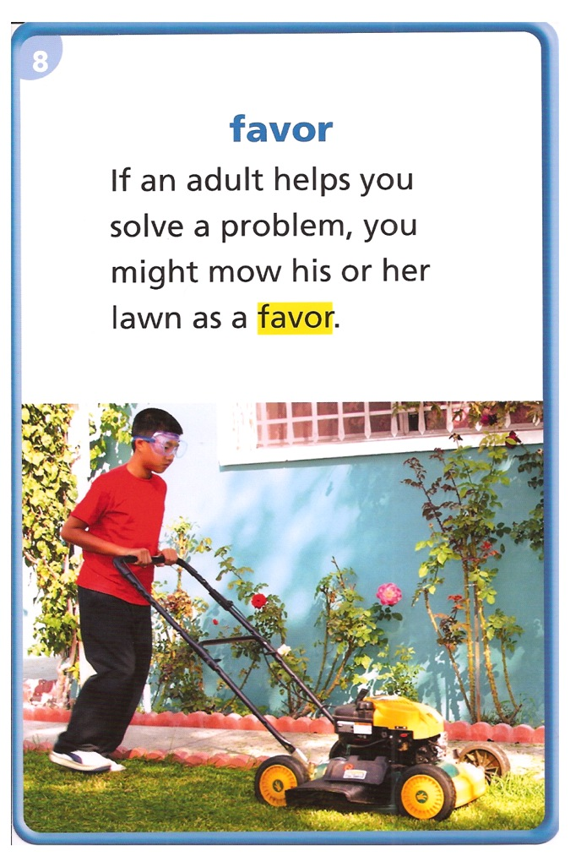
What does it mean?
A favor is an act of kindness that someone does, even though he or she does not have to.
THINK ABOUT IT:
If a friend asked you for a favor, would you do it, even if it would be very hard to do?
Copyright © 2011 Kelly Mott

Slide 27
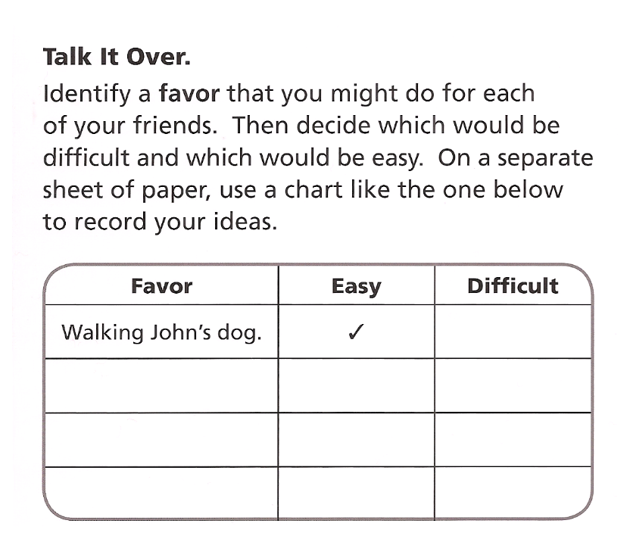
Copyright © 2011 Kelly Mott

Slide 28
speculated
Copyright © 2011 Kelly Mott

Slide 29
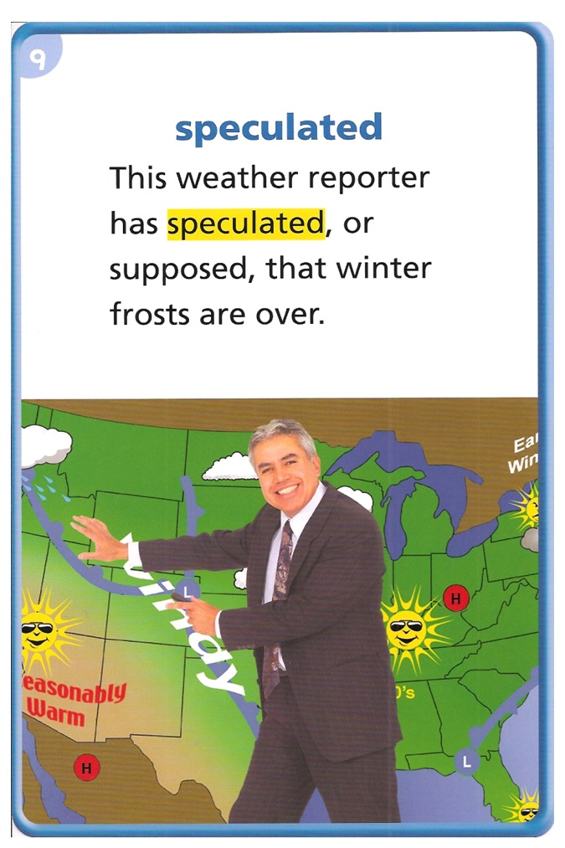
What does it mean?
If a person speculated about a situation, he or she made guesses about it.
THINK ABOUT IT:
Think about a time when you speculated about the answer to a test question.
Copyright © 2011 Kelly Mott

Slide 30
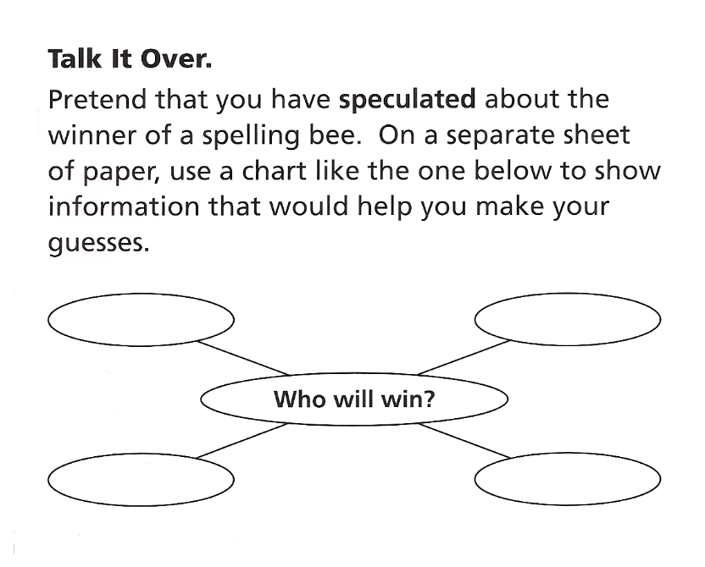
Copyright © 2011 Kelly Mott

Slide 31
prior
Copyright © 2011 Kelly Mott

Slide 32
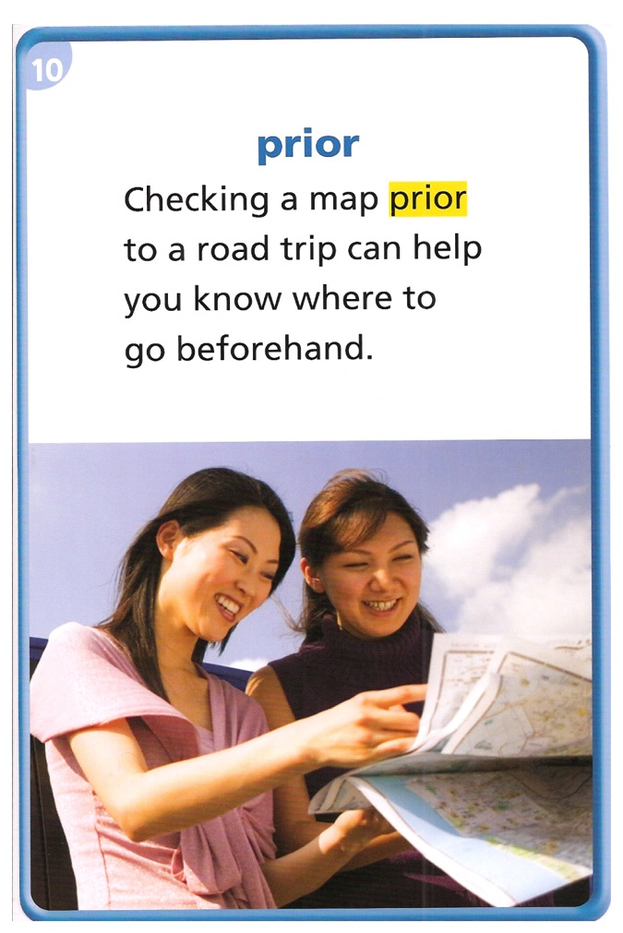
What does it mean?
An event that takes place prior to another event takes place before it.
THINK ABOUT IT:
What is the last step you take prior to turning in your math homework? Why is that step important?
Copyright © 2011 Kelly Mott

Slide 33
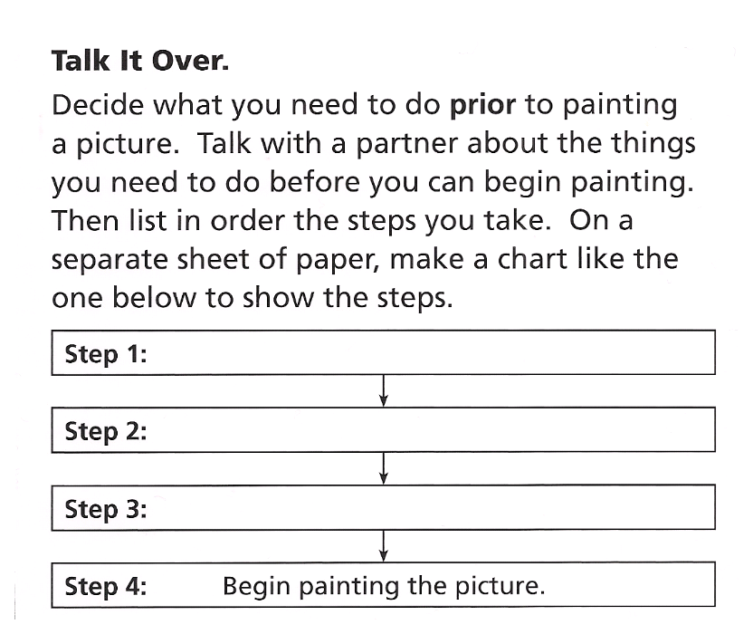
Copyright © 2011 Kelly Mott

Slide 34
Copyright © 2011 Kelly Mott

Slide 35
Part 3: Vocabulary Review
Copyright © 2011 Kelly Mott
Notes:
35

Slide 36

Turn your Book to pages 106-107.
Copyright © 2011 Kelly Mott

Slide 37
Copyright © 2011 Kelly Mott

Slide 38
assist
Copyright © 2011 Kelly Mott

Slide 39
What does it mean?
To assist someone is to help that person.
THINK ABOUT IT:
Who usually comes to assist you when you need help?
Copyright © 2011 Kelly Mott

Slide 40
burglaries
Copyright © 2011 Kelly Mott

Slide 41
What does it mean?
People who commit burglaries break into buildings and steal things.
THINK ABOUT IT:
When your favorite superhero hears about burglaries, what does he or she do?
Copyright © 2011 Kelly Mott

Slide 42
innocent
Copyright © 2011 Kelly Mott

Slide 43
What does it mean?
A person who is innocent has done nothing wrong.
THINK ABOUT IT:
If someone is accused of a crime, how can that person prove that he or she is innocent?
Copyright © 2011 Kelly Mott

Slide 44
scheme
Copyright © 2011 Kelly Mott

Slide 45
What does it mean?
A scheme is a detailed plan to get something done.
THINK ABOUT IT:
How could a scheme help you plan a surprise birthday party?
Copyright © 2011 Kelly Mott

Slide 46
regretfully
Copyright © 2011 Kelly Mott

Slide 47
What does it mean?
If people say something regretfully, they say it in a way that shows they are sorry.
THINK ABOUT IT:
What have you said regretfully and to whom? When you spoke, how did you look and what did you do?
Copyright © 2011 Kelly Mott

Slide 48
misjudged
Copyright © 2011 Kelly Mott

Slide 49
What does it mean?
If a person has misjudged something, the person has formed an incorrect idea about it.
THINK ABOUT IT:
When have you misjudged the distance of a leap or jump?
Copyright © 2011 Kelly Mott

Slide 50
suspect
Copyright © 2011 Kelly Mott

Slide 51
What does it mean?
A suspect is a person who people think might be guilty of a crime.
THINK ABOUT IT:
What are some ways to find out if a suspect really is guilty?
Copyright © 2011 Kelly Mott

Slide 52
favor
Copyright © 2011 Kelly Mott

Slide 53
What does it mean?
A favor is an act of kindness that someone does, even though he or she does not have to.
THINK ABOUT IT:
If a friend asked you for a favor, would you do it, even if it would be very hard to do?
Copyright © 2011 Kelly Mott

Slide 54
speculated
Copyright © 2011 Kelly Mott

Slide 55
What does it mean?
If a person speculated about a situation, he or she made guesses about it.
THINK ABOUT IT:
Think about a time when you speculated about the answer to a test question.
Copyright © 2011 Kelly Mott

Slide 56
prior
Copyright © 2011 Kelly Mott

Slide 57
What does it mean?
An event that takes place prior to another event takes place before it.
THINK ABOUT IT:
What is the last step you take prior to turning in your math homework? Why is that step important?
Copyright © 2011 Kelly Mott

Slide 59
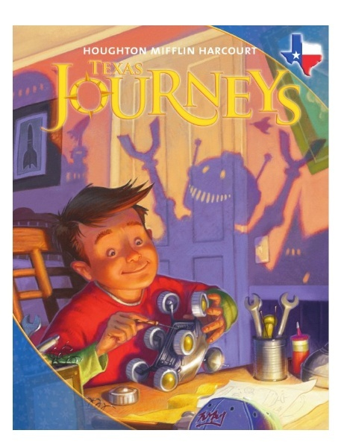
Part 4: Guided Practice
Copyright © 2011 Kelly Mott
Notes:
59

Slide 60
regretfully
Copyright © 2011 Kelly Mott

Slide 61
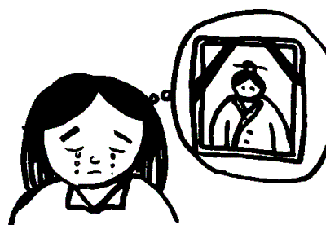
What news might you share regretfully with your friends?
Copyright © 2011 Kelly Mott

Slide 62
speculated
Copyright © 2011 Kelly Mott

Slide 63

When have you speculated about what the ending of a book or movie will be?
Copyright © 2011 Kelly Mott

Slide 64
innocent
Copyright © 2011 Kelly Mott

Slide 65

If someone sounds innocent, is that person likely telling the truth? Explain.
Copyright © 2011 Kelly Mott

Slide 66
suspect
Copyright © 2011 Kelly Mott

Slide 67


When you read a mystery story, what kinds of clues do you use to decide which suspect committed the crime?
Copyright © 2011 Kelly Mott

Slide 68
misjudged
Copyright © 2011 Kelly Mott

Slide 69
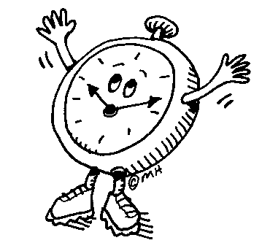
Tell about a time when you misjudged how long it would take to complete a task?
Copyright © 2011 Kelly Mott

Slide 70
assist
Copyright © 2011 Kelly Mott

Slide 71
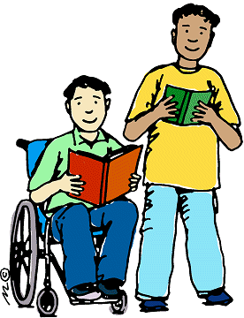
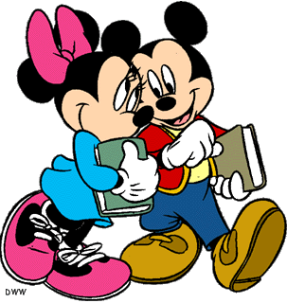
Would you say that friends who assist another friend are helpful? Why or why not?
Copyright © 2011 Kelly Mott

Slide 72
scheme
Copyright © 2011 Kelly Mott

Slide 73


What scheme could you use to get a friend to go to his or her own birthday party?
Copyright © 2011 Kelly Mott

Slide 74
favor
Copyright © 2011 Kelly Mott

Slide 75


Describe a time when you did a favor for someone you didn’t really know.
Copyright © 2011 Kelly Mott

Slide 76
burglaries
Copyright © 2011 Kelly Mott

Slide 77

If there were some burglaries in your neighborhood, what could you do to help police find the criminals?
Copyright © 2011 Kelly Mott

Slide 78
prior
Copyright © 2011 Kelly Mott

Slide 79
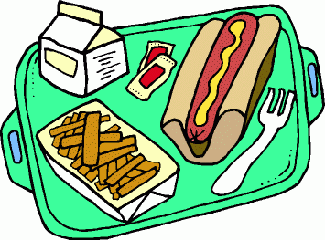
What happens at school prior to lunch?
Copyright © 2011 Kelly Mott

