Slide 1

Harcourt Journeys: Comprehension Skills
Copyright © 2011 Kelly Mott
Notes:
1

Slide 2
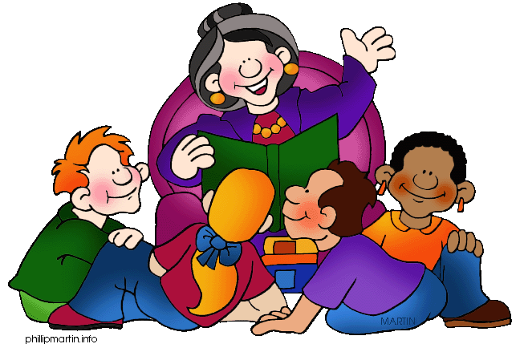
Unit 1: Lesson 3
Skill – Cause and Effect
Copyright © 2011 Kelly Mott
Notes:
2

Slide 3
Part 1: Introduce Comprehension
Copyright © 2011 Kelly Mott
Notes:
3

Slide 4

There is a reason for everything that happens.
Copyright © 2011 Kelly Mott

Slide 5
EXAMPLES
Copyright © 2011 Kelly Mott
Notes:
5

Slide 6
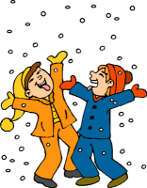
It’s snowy, so I wore my snowsuit.
Copyright © 2011 Kelly Mott

Slide 7
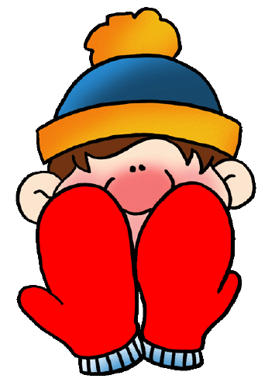
My hands were cold, because I forgot my mittens.
Copyright © 2011 Kelly Mott

Slide 8
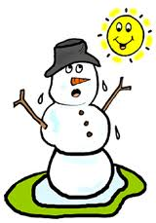
When the sun came out, the snowman started to melt
.
Copyright © 2011 Kelly Mott

Slide 9
What happens is called the…..
EFFECT
Copyright © 2011 Kelly Mott

Slide 10
Why something happens is called the…..
CAUSE
Copyright © 2011 Kelly Mott

Slide 11

Here are a few tips to help you identify cause & effect.
Copyright © 2011 Kelly Mott

Slide 12
TIP
Copyright © 2011 Kelly Mott

Slide 13

THINK about the ORDER in which things happen.
Copyright © 2011 Kelly Mott

Slide 14

The CAUSE always happens FIRST. It makes the EFFECT happen.
Copyright © 2011 Kelly Mott

Slide 15

The EFFECT happens AFTER the CAUSE. It happens SECOND.
Copyright © 2011 Kelly Mott

Slide 16
TIP
Copyright © 2011 Kelly Mott

Slide 17

LOOK for CLUE WORDS.
Copyright © 2011 Kelly Mott

Slide 18
These words signify cause & effect:
Copyright © 2011 Kelly Mott

Slide 19

Signal Word(s):
because
Copyright © 2011 Kelly Mott

Slide 20
Alligators almost became
extinct because people killed too many of them.
Cause: Why Effect: What
Copyright © 2011 Kelly Mott

Slide 21
Signal Word(s):
when
Copyright © 2011 Kelly Mott

Slide 22
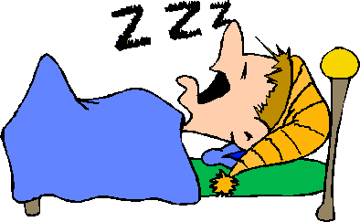
I fall asleep quickly when I’m tired.
Cause: Why Effect: What
Copyright © 2011 Kelly Mott

Slide 23
Signal Word(s):
since
Copyright © 2011 Kelly Mott

Slide 24
Since we ran out of milk, we went to the grocery store.
Cause: Why Effect: What
Copyright © 2011 Kelly Mott

Slide 25
Signal Word(s):
so
Copyright © 2011 Kelly Mott

Slide 26
You should brush your teeth often so you don't get cavities.
Cause: Why Effect: What
Copyright © 2011 Kelly Mott

Slide 27
Signal Word(s):
if
Copyright © 2011 Kelly Mott

Slide 28
If I miss the bus, my mom will give me a ride to school.
Cause: Why Effect: What
Copyright © 2011 Kelly Mott

Slide 29
Signal Word(s):
as a result
Copyright © 2011 Kelly Mott

Slide 30
Powerful winds blew the roof off the house, and
as a result, the family had nowhere to live.
Cause: Why Effect: What
Copyright © 2011 Kelly Mott

Slide 31
Signal Word(s):
therefore
Copyright © 2011 Kelly Mott

Slide 32
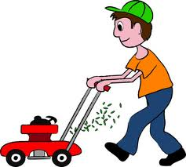
I did all my chores, therefore I will get my allowance.
Cause: Why Effect: What
Copyright © 2011 Kelly Mott

Slide 33
Now, let’s use what we’ve learned to help us identify cause and effect .
Copyright © 2010 Kelly Mott

Slide 35
Part 2: Projectables
Copyright © 2011 Kelly Mott
Notes:
35

Slide 36
Projectable 3.2
Copyright © 2011 Kelly Mott

Slide 37
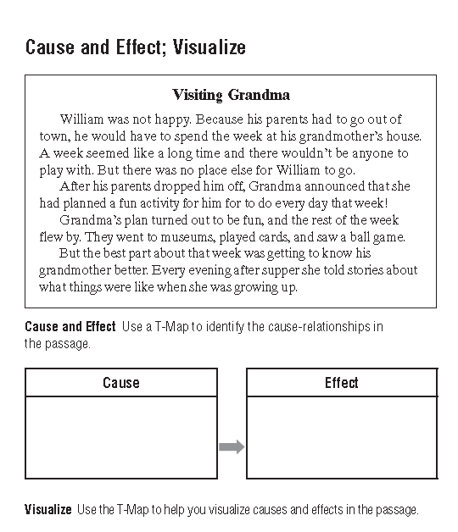

Slide 38
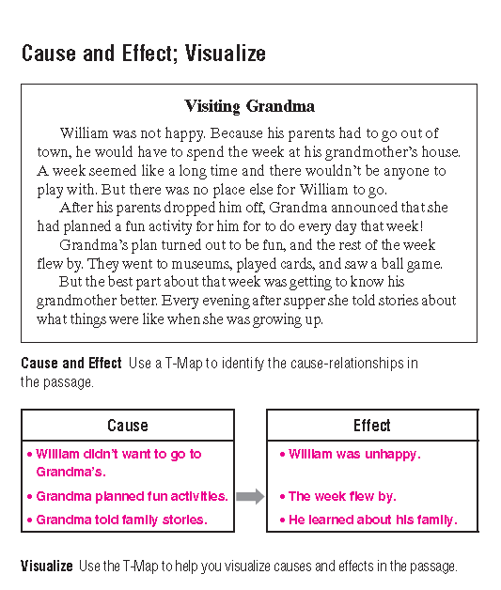

Slide 40

How did you do?
Copyright © 2011 Kelly Mott

Slide 41
Copyright © 2011 Kelly Mott

Slide 42


