Slide 1
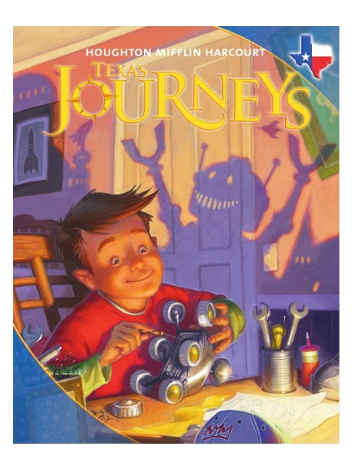
Harcourt Journeys: Story Selection
Copyright © 2011 Kelly Mott
Notes:
1

Slide 2
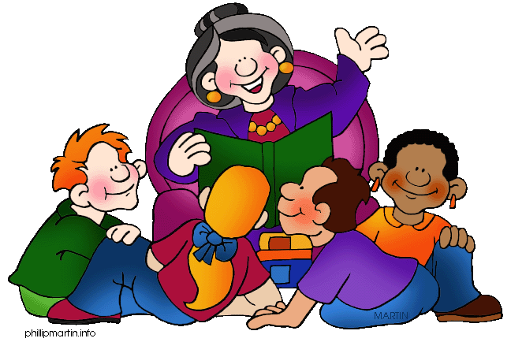
Unit 1: Lesson 2
My Brother Martin
Copyright © 2011 Kelly Mott
Notes:
2

Slide 3

My Brother Martin:
Part 1: Interactive PowerPoint with Guided Reading Questions (from 2011)
Part 2: Projectable 2.2
Copyright © 2011 Kelly Mott

Slide 4

Turn your Text Book to page 48.
Copyright © 2011 Kelly Mott

Slide 5
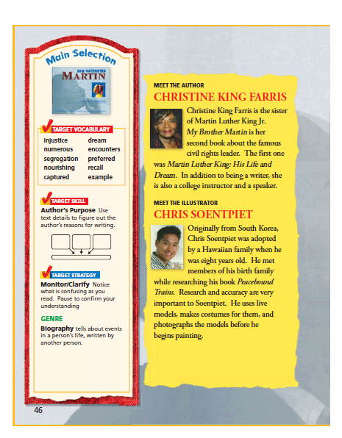

Slide 6
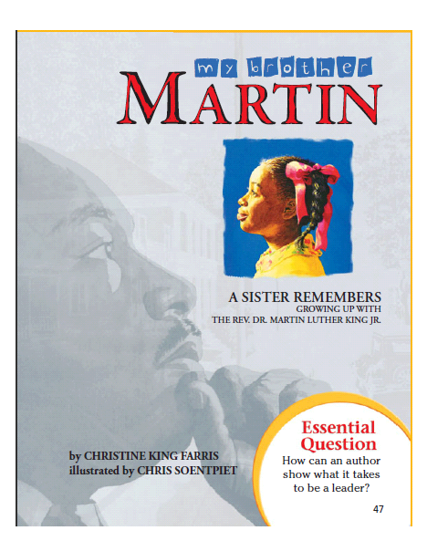
SET A PURPOSE

Slide 7
Good readers set a purpose for reading based on their preview of the story, and what they know about genre.
Copyright © 2011 Kelly Mott

Slide 8
Authors often want readers to learn something, so you should think about what the author wants you to know.
Copyright © 2011 Kelly Mott

Slide 9
What genre do you think this story is?
(Hint: See Pg. 48)
Answer
Copyright © 2011 Kelly Mott

Slide 10
This story is a biography. A biography tells about events in a person’s life and is written by another person.
Copyright © 2011 Kelly Mott

Slide 11
What purpose might we have for reading this story?
Answer
Copyright © 2011 Kelly Mott

Slide 12
Information
Learn about Martin Luther King
and his family.
Learn about what life was like
when Martin Luther King was
growing up.
Copyright © 2011 Kelly Mott

Slide 13
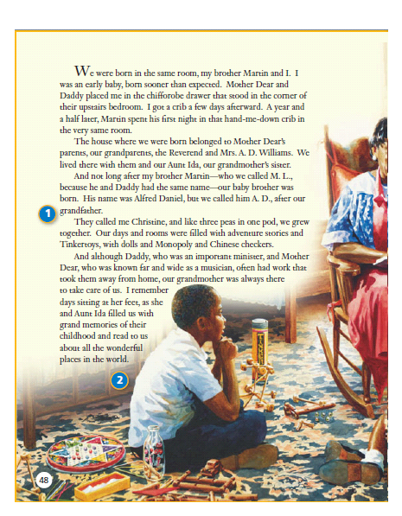
1
2

Slide 14
Why does the story begin with a description of Christine’s family structure?
Answer
Copyright © 2011 Kelly Mott

Slide 15
Answer:
To introduce the main
characters and the setting
in which they grew up.
Copyright © 2011 Kelly Mott

Slide 16
Did the author enjoy life in her childhood home? How do you know?
Answer
Copyright © 2011 Kelly Mott

Slide 17
Possible Answer:
Yes; she felt secure knowing that
her grandmother and brothers
would take care of her when their
parents were away. She liked
listening to the “grand memories”
of her grandmother and
Aunt Ida.
Copyright © 2011 Kelly Mott

Slide 18
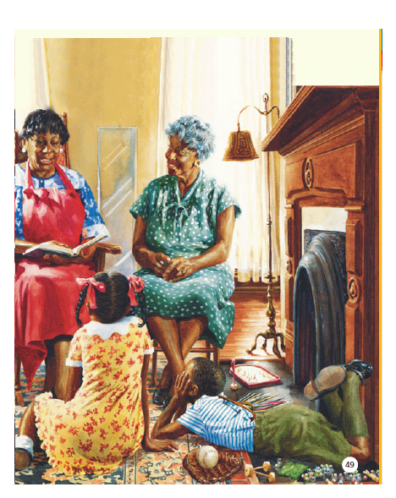

Slide 19
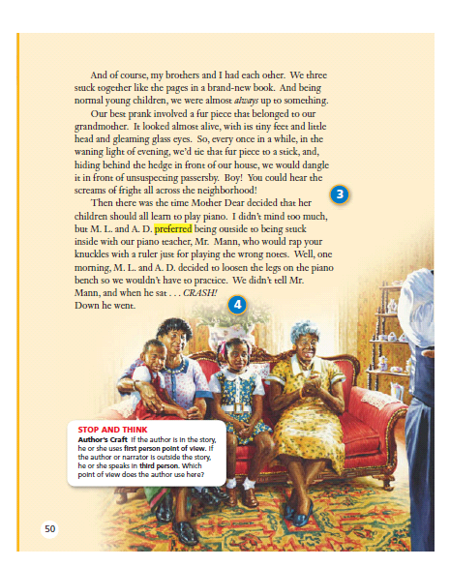
3
4
STOP & THINK

Slide 20
What can you infer about the children from the game they played with their grandmother’s fur?
Answer
Copyright © 2011 Kelly Mott

Slide 21
Possible Answer:
They acted just like ordinary kids.
Copyright © 2011 Kelly Mott

Slide 22
If you had the choice, at what times might you have preferred taking music lessons to playing outside?
Answer
Copyright © 2011 Kelly Mott

Slide 23
Possible Answer:
When the weather outside was bad.
Copyright © 2011 Kelly Mott

Slide 24
STOP & THINK:
Point of View is the way the author tells the story and how he or she interprets what happened.
Copyright © 2011 Kelly Mott

Slide 25
STOP & THINK:
If the author is in the story, he or she uses the first person point of view.
Copyright © 2011 Kelly Mott

Slide 26
STOP & THINK:
If the author or narrator is outside the story, he or she uses the third person point of view.
Copyright © 2011 Kelly Mott

Slide 27
STOP & THINK:
Which point of view do you think the author uses here?
Answer
Copyright © 2011 Kelly Mott

Slide 28
Answer:
First person; notice that Christine King Ferris uses the word “I” to show that she is telling the story.
Copyright © 2011 Kelly Mott

Slide 29
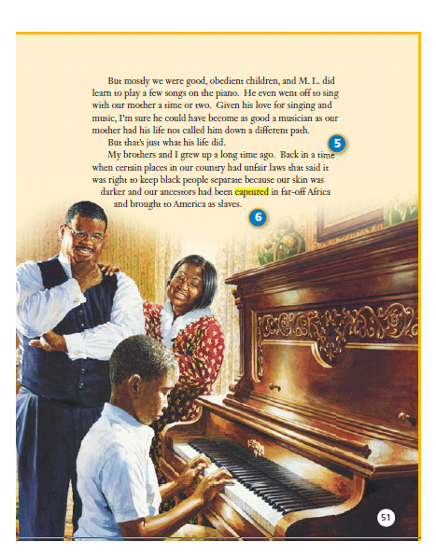
5
6

Slide 30
How might Martin’s life have been different had he chosen a career in music?
Answer
Copyright © 2011 Kelly Mott

Slide 31
Possible Answers:
He might not have worked in the civil rights movement. He might not have died so early.
Copyright © 2011 Kelly Mott

Slide 32
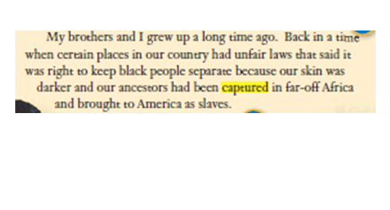
For what reason might the author have included the information on the last paragraph on page 53?
Answer
Copyright © 2011 Kelly Mott

Slide 33
Possible Answers:
To inform readers about the history of African Americans and slavery; to express her feelings about the laws that were in place when she was young.
Copyright © 2011 Kelly Mott

Slide 34
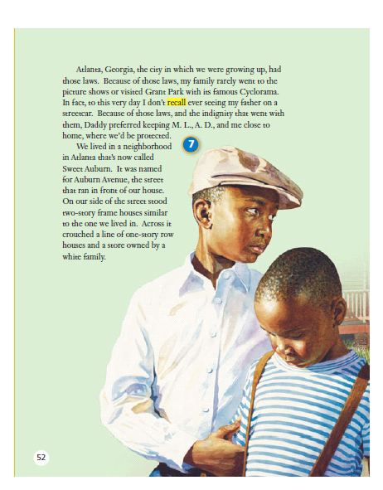
7

Slide 35
The author’s father wanted his children to be protected from unfair laws. What might have happened to African Americans who didn’t obey the unfair laws?
Answer
Copyright © 2011 Kelly Mott

Slide 36
Possible Answers:
They might be arrested. They might be hurt or injured.
Copyright © 2011 Kelly Mott

Slide 37
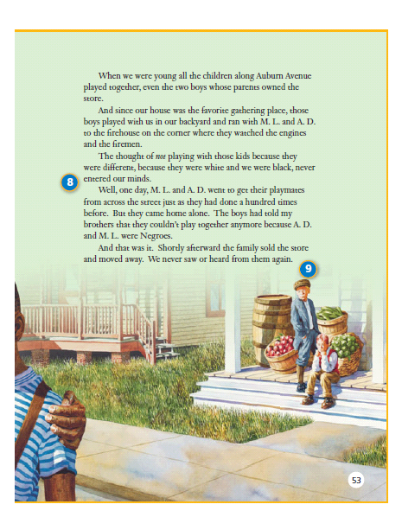
8
9

Slide 38
What can you tell about the children on Auburn Avenue from the fact that they all play together?
Answer
Copyright © 2011 Kelly Mott

Slide 39
Possible Answer:
Skin color wasn’t important to them.
Copyright © 2011 Kelly Mott

Slide 40
What happened to change the behavior of the boys whose parents owned the store?
Answer
Copyright © 2011 Kelly Mott

Slide 41
Possible Answer:
The parents or other adults saw the children playing together and told the boys to stop.
Copyright © 2011 Kelly Mott

Slide 42
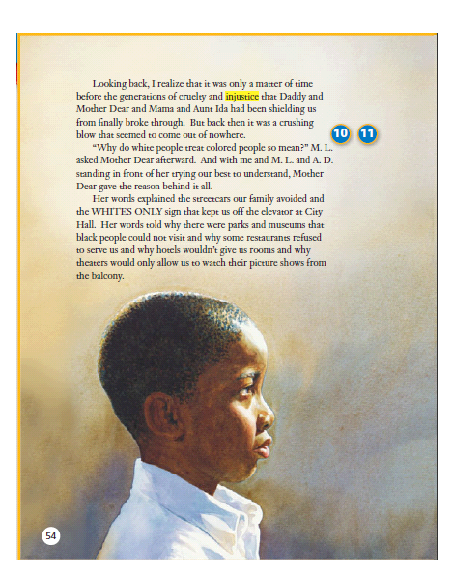
10
11

Slide 43
Why do you think the King children were so shocked when they realized that they were treated differently because of the color of their skin?
Answer
Copyright © 2011 Kelly Mott

Slide 44
Possible Answer:
Their family had shielded them from it so they weren’t aware that such behavior could occur.
Copyright © 2011 Kelly Mott

Slide 45
Which of the following would you consider an injustice: punishing a criminal, calling people names because of the way they dress, or fighting against a weaker person?
Answer
Copyright © 2011 Kelly Mott

Slide 46
Possible Answer:
Calling people names; fighting against a weaker person.
Copyright © 2011 Kelly Mott

Slide 47
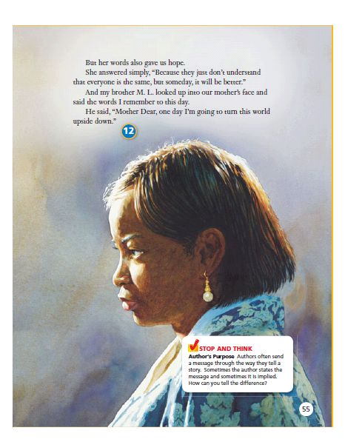
12
STOP & THINK

Slide 48
Why do you think the author included her mother’s statement that “someday, it will be better”?
Answer
Copyright © 2011 Kelly Mott

Slide 49
Possible Answers:
To show that her family was hopeful in spite of the difficulties they faced; to show that her mother had hope for the future; to show that her brother, Martin Luther, was like their mother.
Copyright © 2011 Kelly Mott

Slide 50
STOP & THINK:
The author’s purpose is the reason the author wrote the selection.
Copyright © 2011 Kelly Mott

Slide 51
STOP & THINK:
Remember, an author’s purpose may be to inform, to entertain, to persuade, or to express feelings.
Copyright © 2011 Kelly Mott

Slide 52
STOP & THINK:
Oftentimes, the author’s purpose is not directly stated in the text.
Copyright © 2011 Kelly Mott

Slide 53
STOP & THINK:
Readers have to consider what text details the author has included and why.
Copyright © 2011 Kelly Mott

Slide 54
STOP & THINK:
Readers have to consider what text details the author has included and why.
Copyright © 2011 Kelly Mott

Slide 55
Why do you the author chose to include Martin Luther’s statement that he “would turn the world upside down?
Answer
Copyright © 2011 Kelly Mott

Slide 56
Possible Answer:
To show readers that M.L. felt strongly that it was wrong to treat someone different because of their skin color; to persuade readers to feel the same way as Martin Luther did.
Copyright © 2011 Kelly Mott

Slide 57
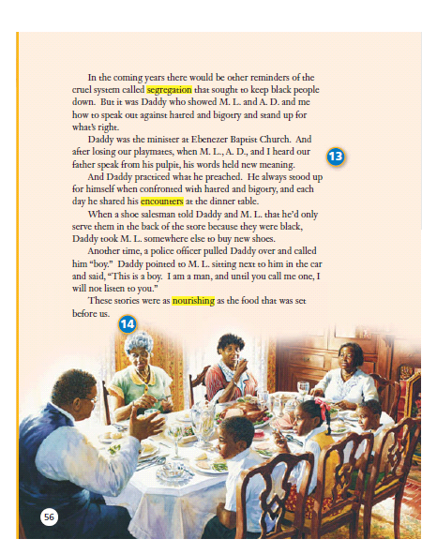
13
14

Slide 58
What happened as a result of the King children losing their playmates?
Answer
Copyright © 2011 Kelly Mott

Slide 59
Possible Answers:
They became aware of segregation for the first time in their lives; they recognized new meaning in their father’s sermons; they realized the need to stand up for themselves.
Copyright © 2011 Kelly Mott

Slide 60
How could stories be as nourishing as food?
Answer
Copyright © 2011 Kelly Mott

Slide 61
Possible Answer:
Nourishing means healthful. Food nourishes the body, while stories are healthful for the spirit by inspiring and giving hope for the future.
Copyright © 2011 Kelly Mott

Slide 62
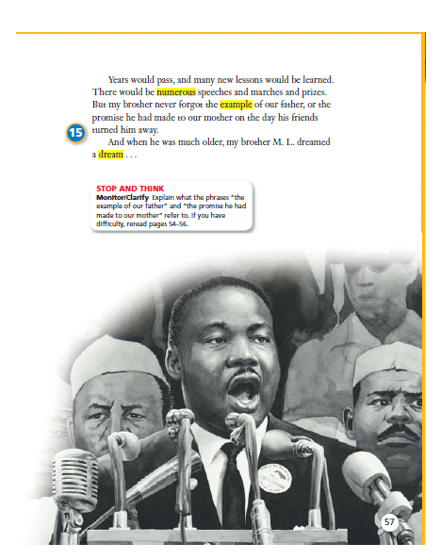
15
STOP & THINK

Slide 63
How does the author use the story to present her own biography?
Answer
Copyright © 2011 Kelly Mott

Slide 64
Possible Answer:
As she tells stories from Martin’s childhood and the lessons he learned, she is also describing her own experiences because she grew up with him.
Copyright © 2011 Kelly Mott

Slide 65
STOP & THINK:
To monitor means to check your understanding. To clarify means to make sense of things that aren’t clear
Copyright © 2011 Kelly Mott

Slide 66
STOP & THINK:
Let’s check your understanding and make sense of this phrase:
“These stories were as nourishing as the food that was set before us.”
Copyright © 2011 Kelly Mott

Slide 67
STOP & THINK:
This phrase means that stories can nourish your mind and help you learn.
Copyright © 2011 Kelly Mott

Slide 68
How did Martin Luther’s father’s stories nourish his family?
Answer
Copyright © 2011 Kelly Mott

Slide 69
Possible Answer:
Showing them how he stood up for himself made them feel comforted and strong, just as food would.
Copyright © 2011 Kelly Mott

Slide 70
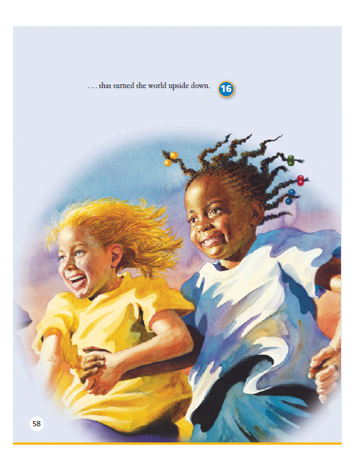
16

Slide 71
Do you have a dream about something you hope will happen someday? Briefly describe it.
Answer
Copyright © 2011 Kelly Mott

Slide 72
Sample Answers:
Getting on the softball team, going to college, world peace….
Copyright © 2011 Kelly Mott

Slide 74
Projectable 2.2
Copyright © 2011 Kelly Mott

Slide 75
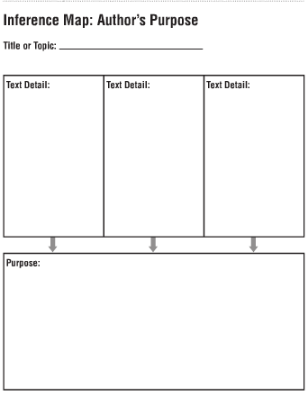

Slide 76
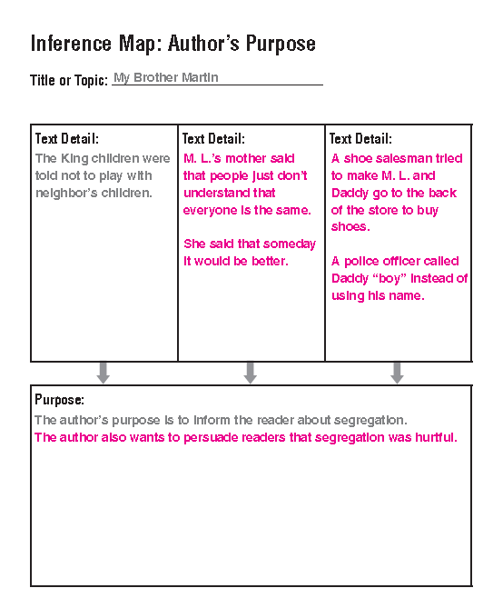

Slide 78
Projectable 2.4
Copyright © 2011 Kelly Mott

Slide 79
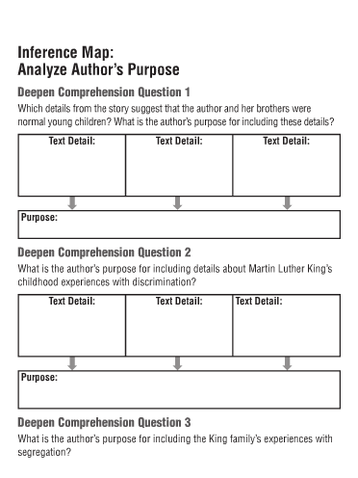

Slide 80
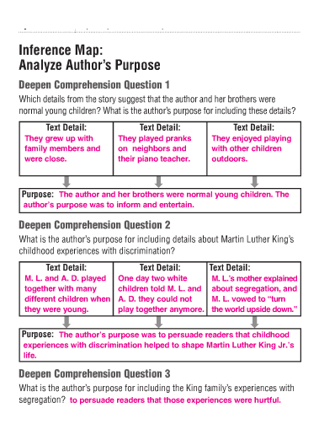

Slide 82
Copyright © 2011 Kelly Mott

Slide 83

How did you do?
Copyright © 2011 Kelly Mott

Slide 84


