Slide 1

Unit 1: Lesson 1
Vocabulary
Copyright © 2011 Kelly Mott
Notes:
1

Slide 2

Vocabulary:
Part 1: Vocabulary Cards
Part 2: Vocabulary Cards (without back activity)
Part 3: Guided Practice Questions
Copyright © 2011 Kelly Mott

Slide 3
Part 1: Introduce Vocabulary
Copyright © 2011 Kelly Mott
Notes:
3

Slide 4
Turn your Book to pages 16-17.
Copyright © 2011 Kelly Mott

Slide 5
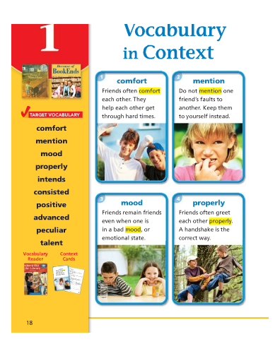
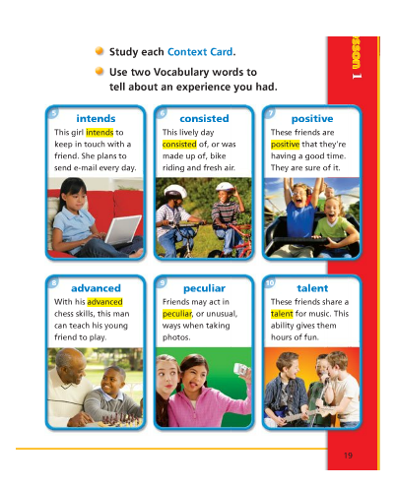
Copyright © 2011 Kelly Mott

Slide 6
comfort
Copyright © 2011 Kelly Mott

Slide 7
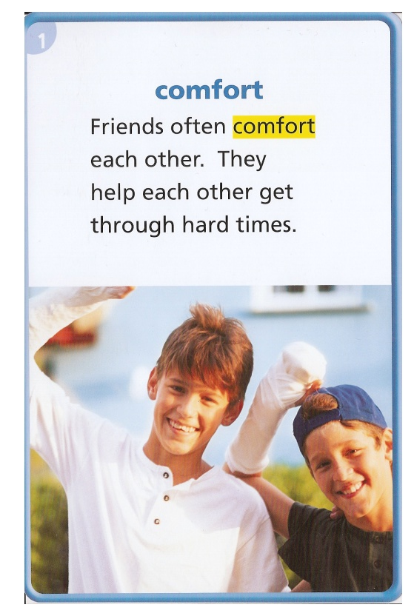
What does it mean?
When you comfort someone, you help that person to feel less bad.
THINK ABOUT IT:
When did you comfort someone? Why did that person need your help?
Copyright © 2011 Kelly Mott

Slide 8
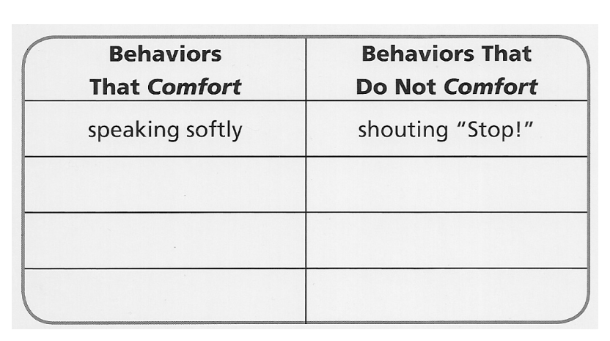
TALK IT OVER:
On a separate sheet of paper, Make a list of behaviors that comfort people and behaviors that do not.
Copyright © 2011 Kelly Mott

Slide 9
mention
Copyright © 2011 Kelly Mott

Slide 10
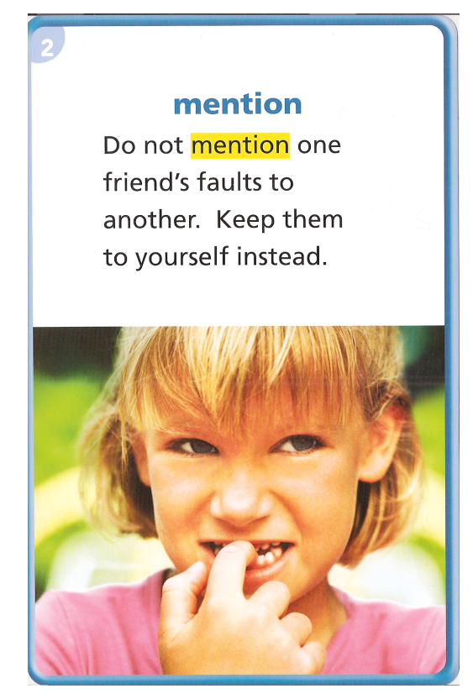
What does it mean?
To mention something is to speak about it.
THINK ABOUT IT:
Which event will you mention to a friend today? Why?
Copyright © 2011 Kelly Mott

Slide 11
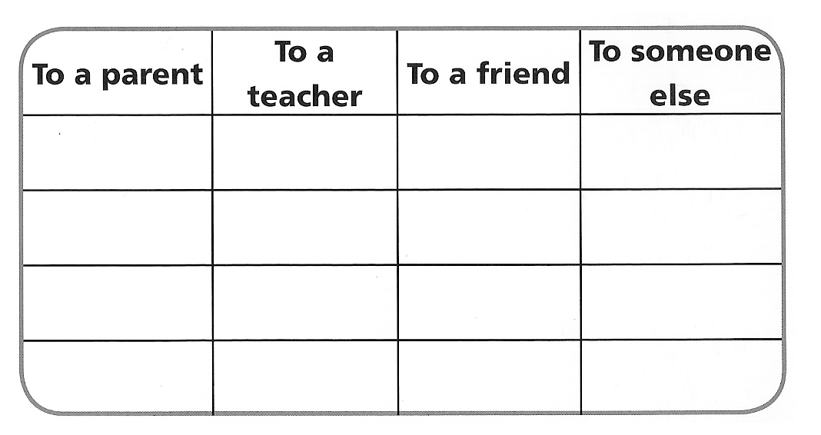
TALK IT OVER:
Think about some important and unimportant things that you might mention. Will you mention them to a parent, to a teacher, to a friend, or someone else?
Copyright © 2011 Kelly Mott

Slide 12
mood
Copyright © 2011 Kelly Mott

Slide 13
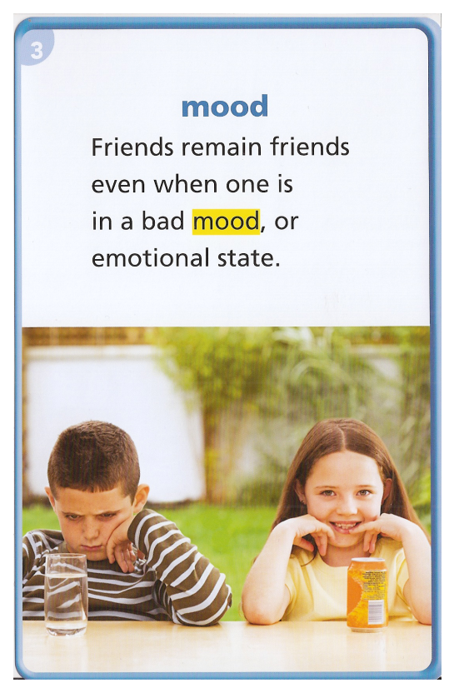
What does it mean?
A person’s mood is the way that the person is feeling
THINK ABOUT IT:
What mood were you in when school ended for summer vacation last year? How did you express that mood?
Copyright © 2011 Kelly Mott

Slide 14
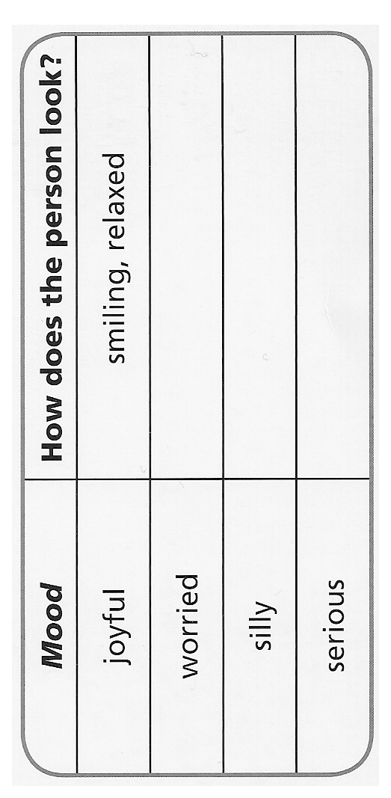
TALK IT OVER:
How do you know when a person is in a particular mood? Copy the chart below on a separate sheet of paper. Then complete the chart.
Copyright © 2011 Kelly Mott

Slide 15
properly
Copyright © 2011 Kelly Mott

Slide 16
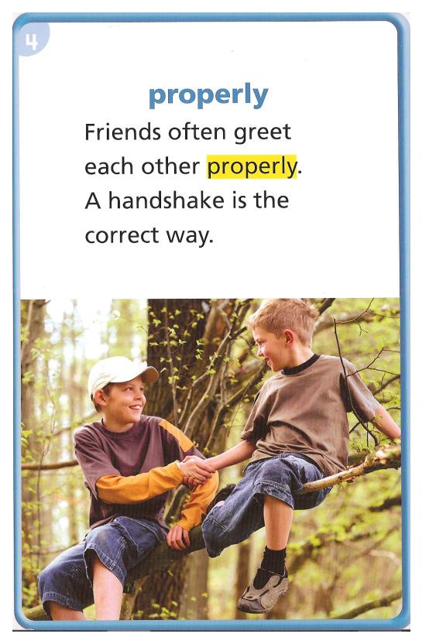
What does it mean?
When you do something properly, you do it the right way.
THINK ABOUT IT:
When have you done something twice in order to do it properly? Tell what you did.
Copyright © 2011 Kelly Mott

Slide 17
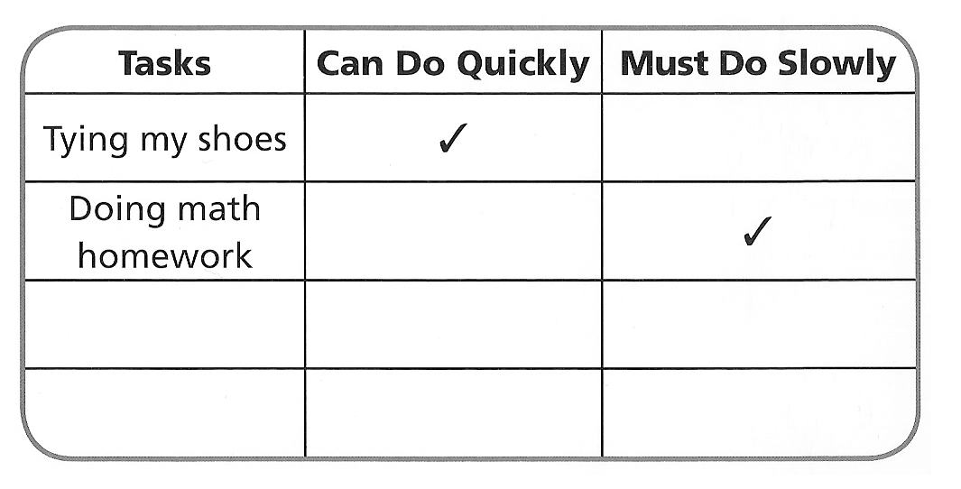
TALK IT OVER:
Work with a partner to list tasks that you must do properly. Decide which you can do quickly and which you must do slowly.
Copyright © 2011 Kelly Mott

Slide 18
intends
Copyright © 2011 Kelly Mott

Slide 19
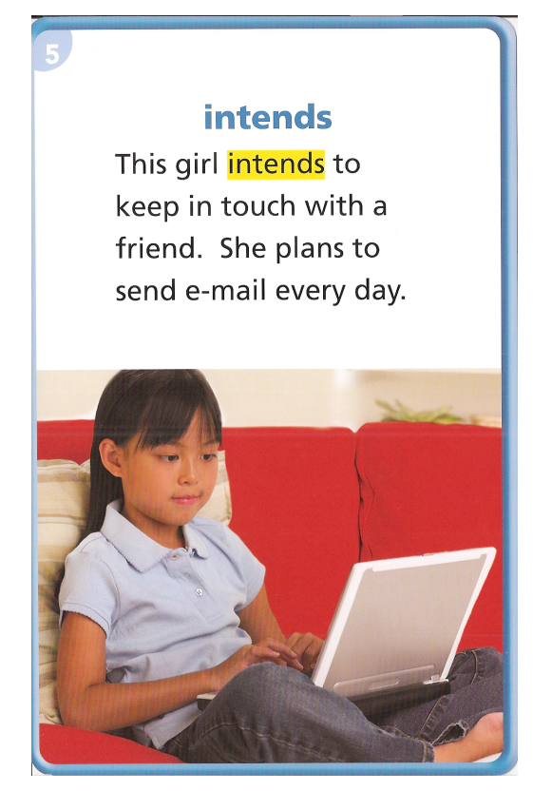
What does it mean?
A person who intends to do a task plans to do that task in the future.
THINK ABOUT IT:
If a girl says that she intends to make the soccer team, what could she do to make that happen?
Copyright © 2011 Kelly Mott

Slide 20
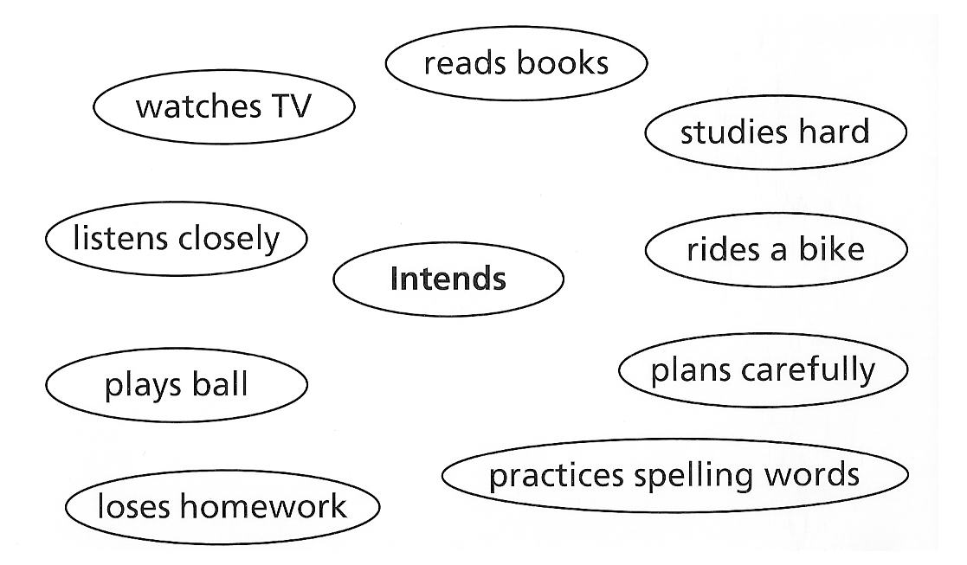
TALK IT OVER:
Copy the web chart below. Draw lines to the words that show how a student intends to get all A’s on her report card.
Copyright © 2011 Kelly Mott

Slide 21
consisted
Copyright © 2011 Kelly Mott

Slide 22
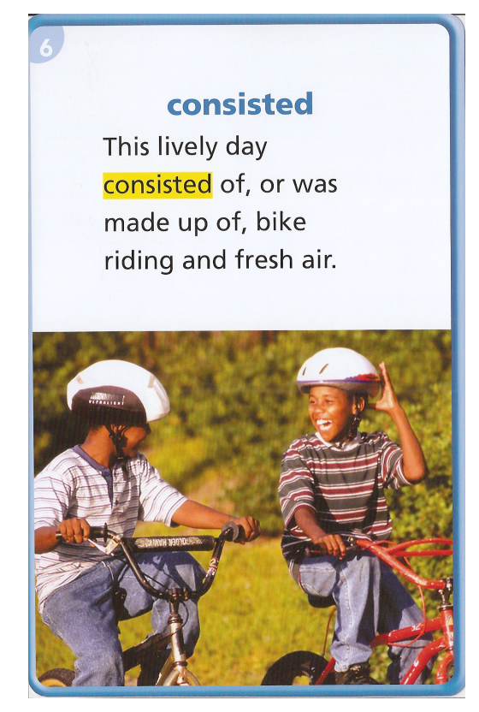
What does it mean?
Something that consisted of different parts was made up of those parts.
THINK ABOUT IT:
What have you made in art class? Which projects consisted of different materials?
Copyright © 2011 Kelly Mott

Slide 23
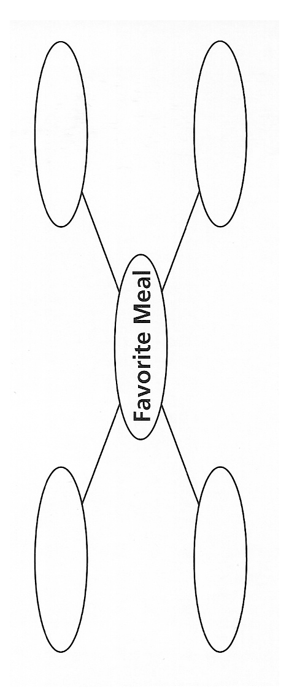
TALK IT OVER:
Think of a meal that you really enjoyed. The meal consisted of a few different things. Write the food and drink the meal consisted of in the ovals.
Copyright © 2011 Kelly Mott

Slide 24
positive
Copyright © 2011 Kelly Mott

Slide 25
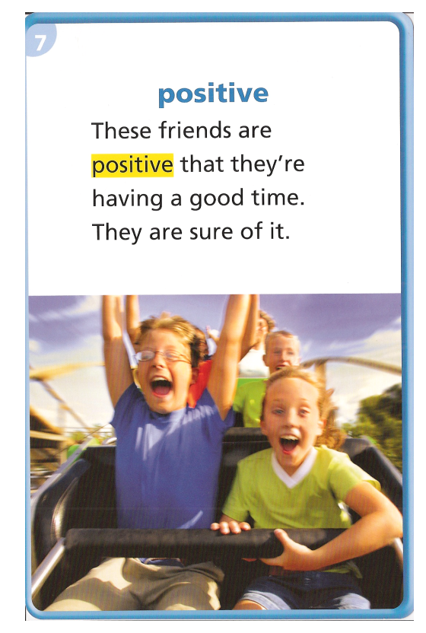
What does it mean?
When people are positive that they know something, they are completely sure.
THINK ABOUT IT:
When were you positive about something, only to find out you were wrong?
Copyright © 2011 Kelly Mott

Slide 26
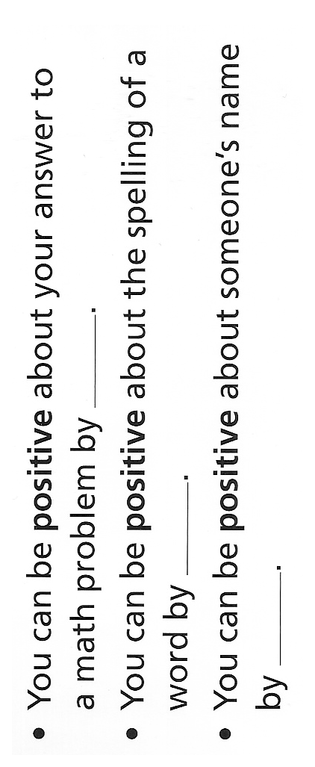
TALK IT OVER:
Copy the sentences below. Then complete the sentences with a partner. Decide together how you can be positive.
Copyright © 2011 Kelly Mott

Slide 27
advanced
Copyright © 2011 Kelly Mott

Slide 28
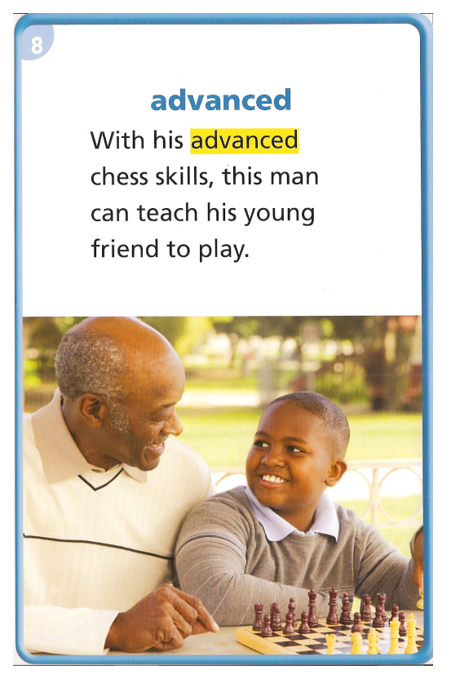
What does it mean?
Someone who has advanced skills in something is very good at it.
THINK ABOUT IT:
What advanced skills do you have? Describe those skills.
Copyright © 2011 Kelly Mott

Slide 29
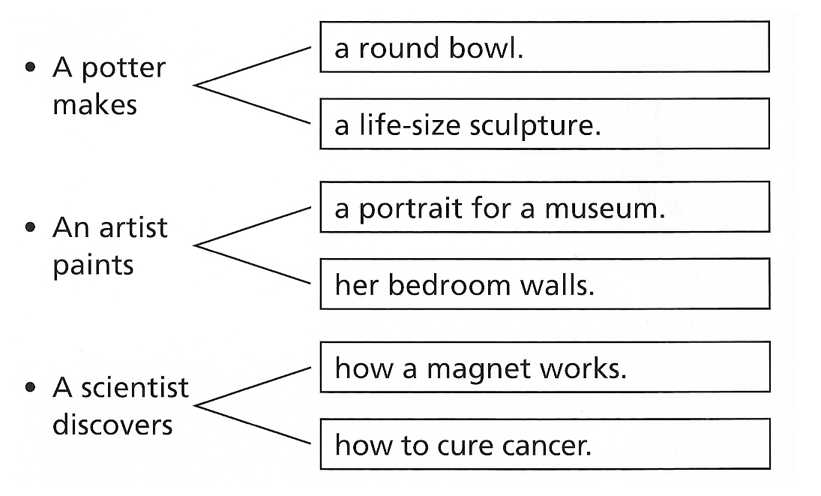
TALK IT OVER:
With a partner, decide which task required advanced skills. Explain your reasons for each decision.
Copyright © 2011 Kelly Mott

Slide 30
peculiar
Copyright © 2011 Kelly Mott

Slide 31
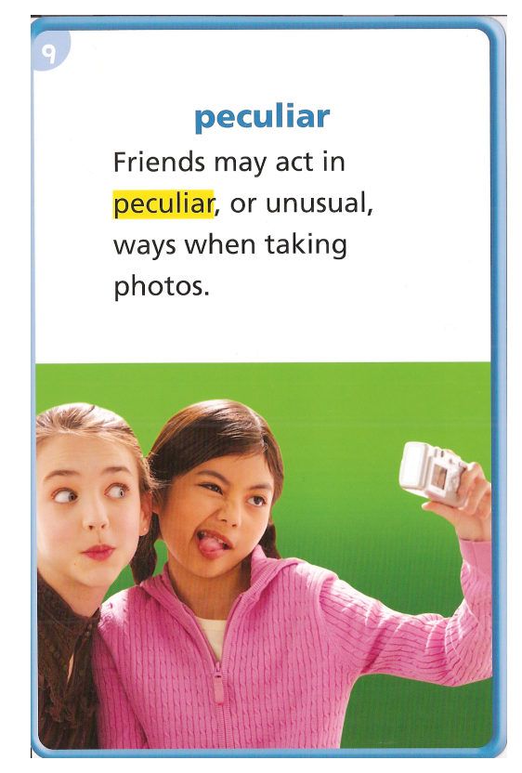
What does it mean?
Something odd or unusual is peculiar.
THINK ABOUT IT:
What peculiar sounds have you heard? What made them peculiar?
Copyright © 2011 Kelly Mott

Slide 32
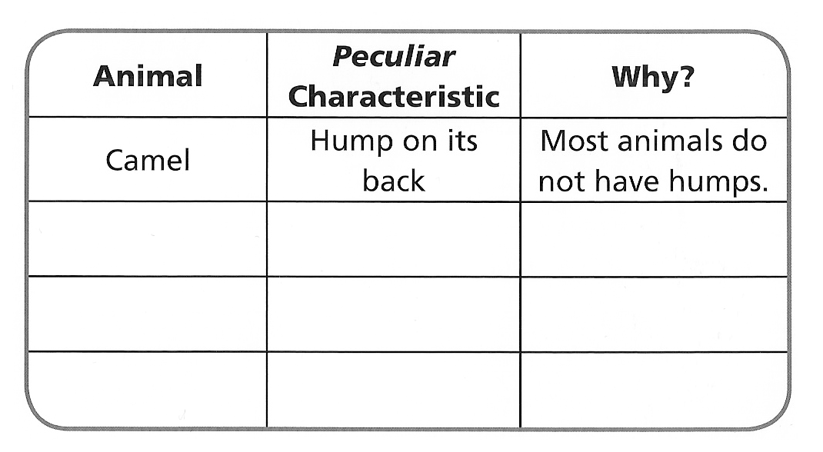
TALK IT OVER:
Which animals have peculiar characteristics? Tell what is peculiar about each one.
Copyright © 2011 Kelly Mott

Slide 33
talent
Copyright © 2011 Kelly Mott

Slide 34
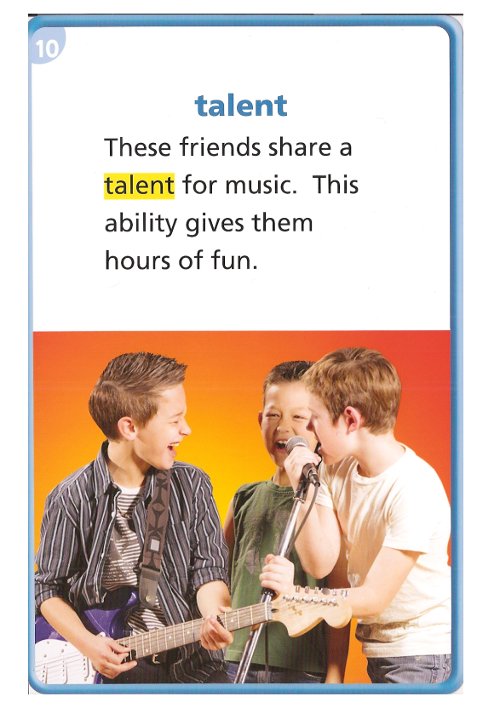
What does it mean?
A talent is a special skill.
THINK ABOUT IT:
What talent do you think is the hardest to develop? Why?
Copyright © 2011 Kelly Mott

Slide 35
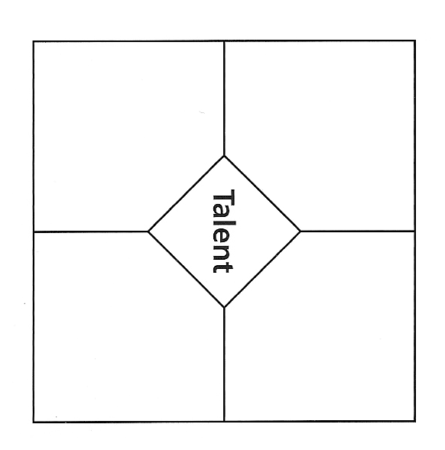
TALK IT OVER:
List a talent you would like to develop. In each section, write something you could do to develop that talent.
Copyright © 2011 Kelly Mott

Slide 37
Part 2: Vocabulary Review
Copyright © 2011 Kelly Mott
Notes:
37

Slide 38
Turn your Book to pages 16-17.
Copyright © 2011 Kelly Mott

Slide 39
Copyright © 2011 Kelly Mott

Slide 40
comfort
Copyright © 2011 Kelly Mott

Slide 41
What does it mean?
When you comfort someone, you help that person to feel less bad.
THINK ABOUT IT:
When did you comfort someone? Why did that person need your help?
Copyright © 2011 Kelly Mott

Slide 42
mention
Copyright © 2011 Kelly Mott

Slide 43
What does it mean?
To mention something is to speak about it.
THINK ABOUT IT:
Which event will you mention to a friend today? Why?
Copyright © 2011 Kelly Mott

Slide 44
mood
Copyright © 2011 Kelly Mott

Slide 45
What does it mean?
A person’s mood is the way that the person is feeling
THINK ABOUT IT:
What mood were you in when school ended for summer vacation last year? How did you express that mood?
Copyright © 2011 Kelly Mott

Slide 46
properly
Copyright © 2011 Kelly Mott

Slide 47
What does it mean?
When you do something properly, you do it the right way.
THINK ABOUT IT:
When did have you done something twice in order to do it properly? Tell what you did.
Copyright © 2011 Kelly Mott

Slide 48
intends
Copyright © 2011 Kelly Mott

Slide 49
What does it mean?
A person who intends to do a task plans to do that task in the future.
THINK ABOUT IT:
If a girl says that she intends to make the soccer team, what could she do to make that happen?
Copyright © 2011 Kelly Mott

Slide 50
consisted
Copyright © 2011 Kelly Mott

Slide 51
What does it mean?
Something that consisted of different parts was made up of those parts.
THINK ABOUT IT:
What have you made in art class? Which projects consisted of different materials?
Copyright © 2011 Kelly Mott

Slide 52
positive
Copyright © 2011 Kelly Mott

Slide 53
What does it mean?
When people are positive that they know something, they are completely sure.
THINK ABOUT IT:
When were you positive about something, only to find out you were wrong?
Copyright © 2011 Kelly Mott

Slide 54
advanced
Copyright © 2011 Kelly Mott

Slide 55
What does it mean?
Someone who has advanced skills in something is very good at it.
THINK ABOUT IT:
What advanced skills do you have? Describe those skills.
Copyright © 2011 Kelly Mott

Slide 56
peculiar
Copyright © 2011 Kelly Mott

Slide 57
What does it mean?
Something odd or unusual is peculiar.
THINK ABOUT IT:
What peculiar sounds have you heard? What made them peculiar?
Copyright © 2011 Kelly Mott

Slide 58
talent
Copyright © 2011 Kelly Mott

Slide 59
What does it mean?
A talent is a special skill.
THINK ABOUT IT:
What talent do you think is the hardest to develop? Why?
Copyright © 2011 Kelly Mott

Slide 61
Part 3: Guided Practice
Copyright © 2011 Kelly Mott
Notes:
61

Slide 62
advanced
Copyright © 2011 Kelly Mott

Slide 63

Do you think an advanced math class would be easy or hard? Why?
Copyright © 2011 Kelly Mott

Slide 64
talent
Copyright © 2011 Kelly Mott

Slide 65
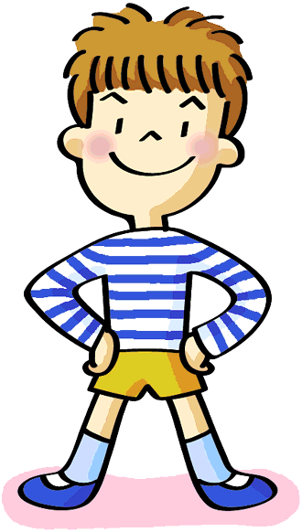
What is one talent you wish you had?
Copyright © 2011 Kelly Mott

Slide 66
mood
Copyright © 2011 Kelly Mott

Slide 67
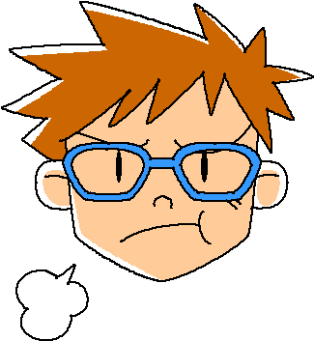
How can you cheer up a person who is in a bad mood?
Copyright © 2011 Kelly Mott

Slide 68
intends
Copyright © 2011 Kelly Mott

Slide 69

If someone intends to buy a new book, where should that person go?
Copyright © 2011 Kelly Mott

Slide 70
comfort
Copyright © 2011 Kelly Mott

Slide 71
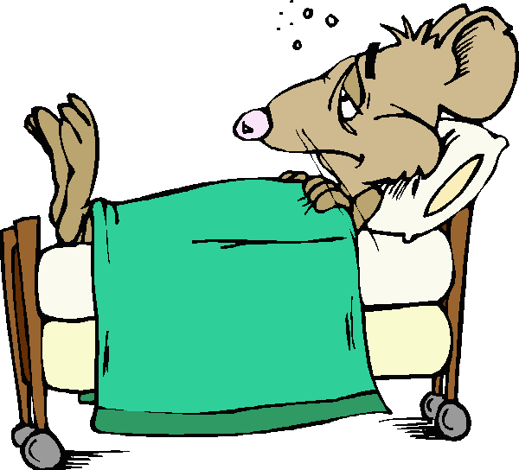
What thinks comfort you when you are sick? Why?
Copyright © 2011 Kelly Mott

Slide 72
consisted
Copyright © 2011 Kelly Mott

Slide 73
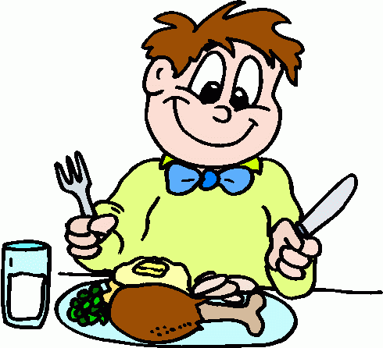
Tell what foods your last meal consisted of.
Copyright © 2011 Kelly Mott

Slide 74
properly
Copyright © 2011 Kelly Mott

Slide 75
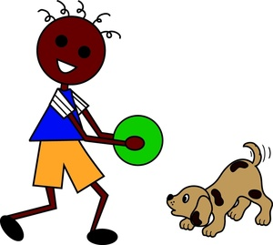
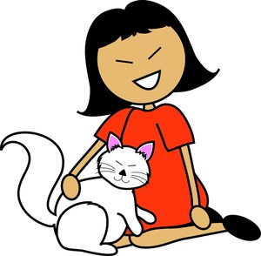
What is one important part of properly caring for a pet?
Copyright © 2011 Kelly Mott

Slide 76
positive
Copyright © 2011 Kelly Mott

Slide 77

How can you be positive that you spelled the word correctly?
Copyright © 2011 Kelly Mott

Slide 78
peculiar
Copyright © 2011 Kelly Mott

Slide 79
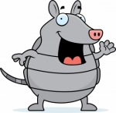
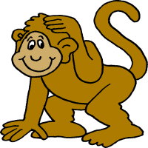

What do you think is the most peculiar animal? Why?
Copyright © 2011 Kelly Mott

Slide 80
mention
Copyright © 2011 Kelly Mott

Slide 81

What could happen if you forgot to mention the time of your birthday party to the people you invited?
Copyright © 2011 Kelly Mott

